Slide 1
Design, Implementation and Management of Database Systems
Storage, Buffer Management, and Indexes
Dr. Xiao Yan
School of Computer Science
yanxiaosunny@whu.edu.cn

Slide 2
Part 1: DBMS Storage and Buffer Management

Slide 3
Prereq: A Look at Memory
Not all memory are equal
  Primary Storage: main memory (RAM)
    fast access, expensive
    hold currently used data
  Secondary storage: hard disk, SSD
    slower access, less expensive
  Tertiary storage: tapes, cd, glass etc.
    slowest access, cheapest

Slide 4
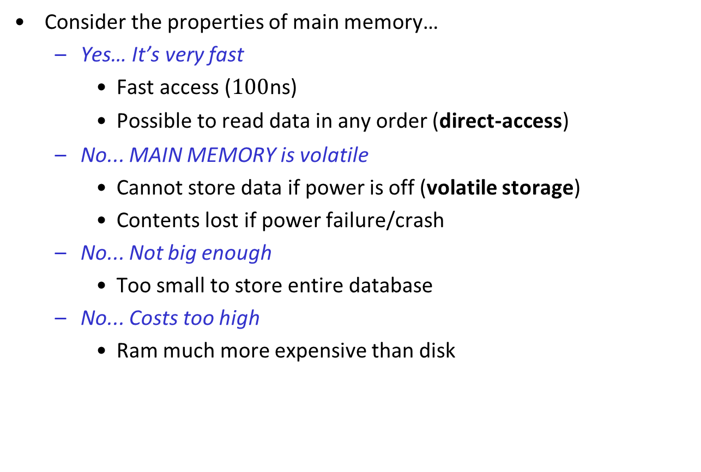
Prereq: Store DB in MM?
Consider the properties of main memory…
  Yes… It’s very fast
    Fast access ($100$ns)
    Possible to read data in any order (direct-access)
  No... MAIN MEMORY is volatile
    Cannot store data if power is off (volatile storage)
    Contents lost if power failure/crash
  No... Not big enough
    Too small to store entire database
  No... Costs too high
    Ram much more expensive than disk

Slide 5
Prereq: Disk-based Storage
The DBMS is practically stored on disk - Primary medium for the long-term storage of data.
  Similarities to Main Memory
    Possible to read data on disk in any order (direct-access)
  Differences from Main Memory
    Stores data when power is off
    Typically large enough to stores entire database
    Survives power failures and system crashes (non-volatile storage)
    Block-based access (4KB pages, read amplification)
    Longer latency (100ns vs 100us), lower bandwidth and IOPS

Slide 6
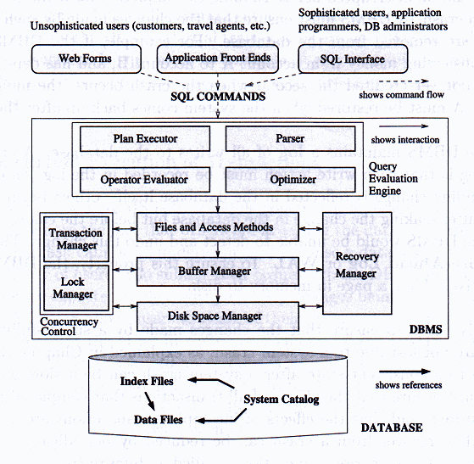
Context: Architecture of DBMS

Slide 7
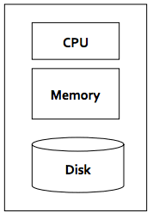
Storage Access: Buffering
Data are transferred between disk and main memory in units of blocks
There are two main costs for DBMS, CPU and I/O (Input/Output)
  CPU cost is to process data in main memory
  I/O cost is to read/write data from/into disk
  The dominating cost is I/O cost
Database system seeks to minimize the number of block transfers between the disk and memory

Slide 8
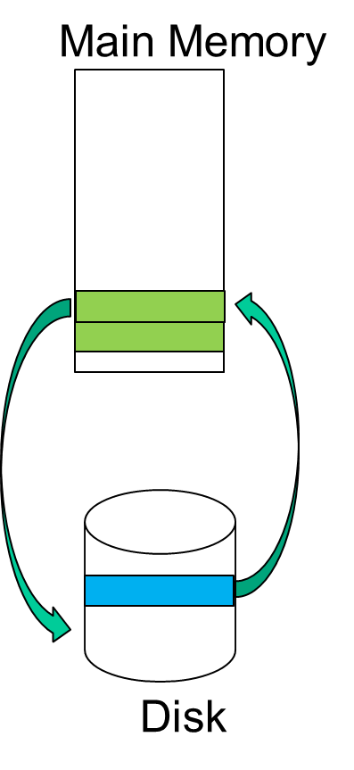
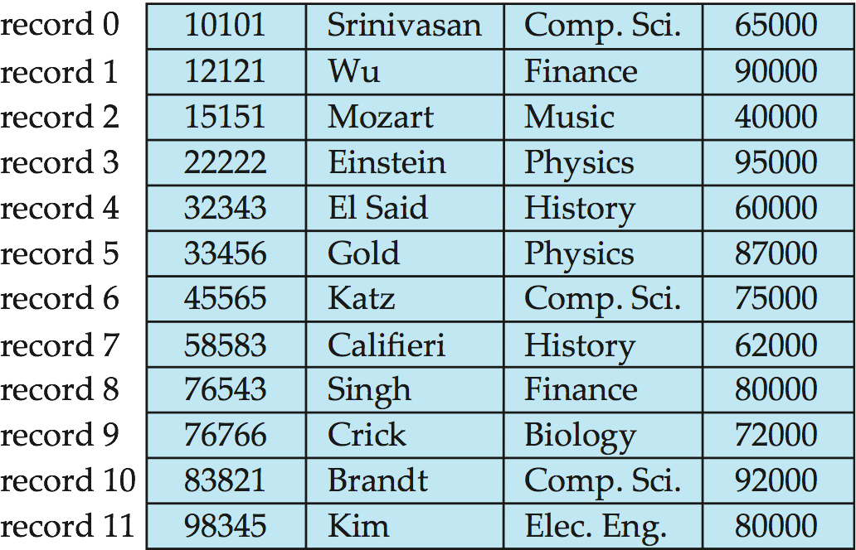
Storage and File Structure
Relation stored as file
  is a sequence of blocks, where a block (or a page) is a fixed-length storage unit
Relation stored on disk
Rough idea of scale, on relations student and takes
  Num records of student = 5, 000
  (Num blocks of student = 100)
Notes:
8

Slide 9
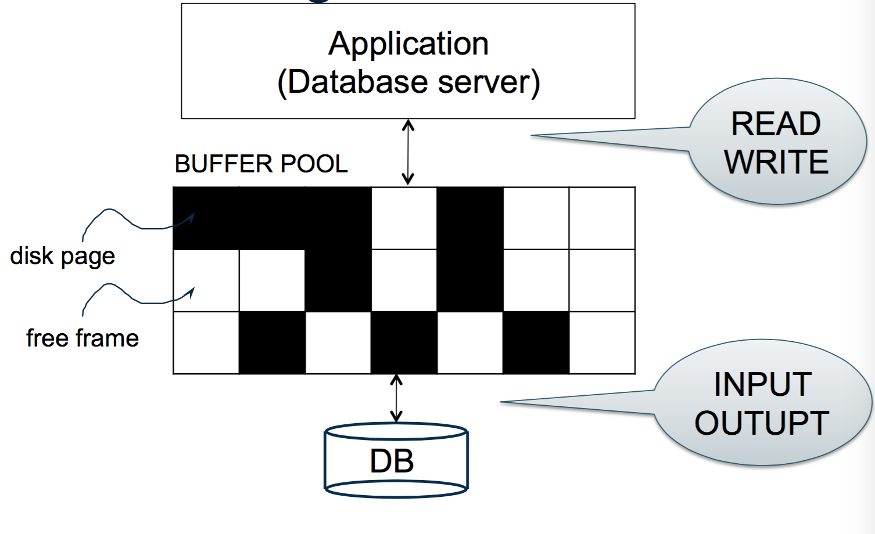
Disk Buffer in DBMS
Aka Buffer Pool – portion of main memory available to store copies of disk blocks
  Blocks residing on disk referred to as physical blocks
  (copy of) blocks residing temporarily in main memory referred to as buffer blocks

Slide 10
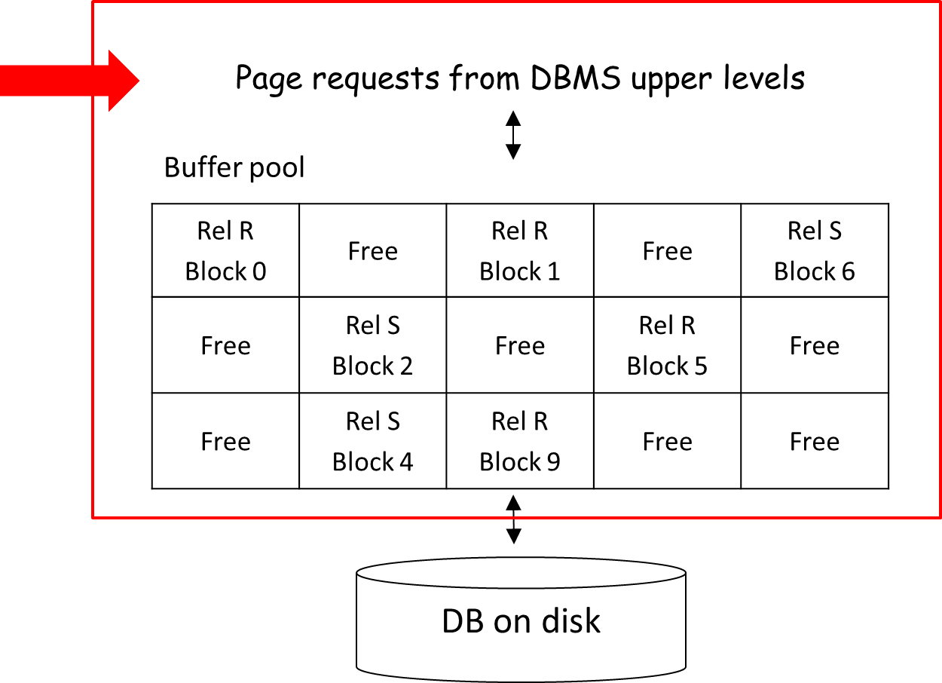
I/O Cost
Important: No I/O Cost between Application and Main Mem.

Slide 11
Case 1: Found in Buffer
Buffer manager – subsystem responsible for allocating buffer space in main memory
If the block is already in buffer
  buffer manager returns address of block in main mem.
  I/O cost avoided
“Yah, we have that in stock”
Buffer pool on MM
Page requests from DBMS upper levels
Rel R Block 0 | Free | Rel R Block 1 | Free | Rel S Block 6
Free | Rel S Block 2 | Free | Rel R Block 5 | Free
Free | Rel S Block 4 | Rel R Block 9 | Free | Free
“Can I get a
Block 1 from Rel R please”

Slide 12
Buffer Pool Operations (0)
Programs call on buffer manager when they need a block from disk
request_block operation
  [CASE ONE] If block is already in buffer pool:
    no need to read it again
    use the copy there
    Pin the page, increment pin count
    returns the address of the block in main memory to requester.

Slide 13
Buffer Pool Operations (1)
Once each requestor is done using block
  requestor must unpin it
  requestor would’ve indicated whether a block has been modified
release_block Operation called.
    Decrement pin count for specified page
    No real effect until replacement required
write_block Operation called.
    Updates contents of page in pool
    Set dirty bit on (indicates if page is modified)
    (Doesn’t actually write to disk, until been replaced, or forced to commit)
force_block operation called.
  "commits" by writing to disk.

Slide 14
Case 2: Not in Buffer
Buffer manager – subsystem responsible for allocating buffer space in main memory
If the block is not in buffer
  disk read is unavoidable
  I/O cost necessary
“Let me check the back”
Buffer pool on MM
“Found it~”
Rel R Block 0 | Free | Rel R Block 1 | Free | Rel S Block 6
Free | Rel S Block 2 | Free | Rel R Block 5 | Free
Free | Rel S Block 4 | Rel R Block 9 | Free | Free
Page requests from DBMS upper levels
DB on disk
“Can I get a
Block 5 from Rel S please”
Notes:
14

Slide 15
Buffer Pool Operations (2)
The request_block operation is called.
  [CASE TWO] If block is not in buffer pool yet:
  Needs to find a frame for the new block
    Place it in a free frame
    If none available, make space by replacing the contents of an occupied frame
  If the replaced frame is dirty, write the block content to disk
    Replaced block written back to disk only if it was modified since the most recent time that it was written to/fetched from the disk.
Read requested page into chosen frame
  Reads the block from the disk to the buffer,
  Pin the page, increment pin count
  return address of the block in main memory to requester.

Slide 16
Buffer Pool Metadata
For each frame, the manager keeps track of:
  whether currently in use
  whether modified since loading (dirty bit)
  how many transactions are currently using it (pin count)
  (some but not all) time-stamp of most recent access (usually for buffer replacement)

Slide 17
Buffer-Replacement Policies
Frame is chosen for replacement by a replacement policy:
  Least-recently-used (LRU), Clock, MRU etc.
  Generally, uses past usage patterns of block as an indicator of future references
Least Recently Used (LRU) – used by most sys.
  release the frame that has not been used for the longest period
  Aka: the one I used just now may be needed very soon
  intuitively appealing idea but can perform badly
Notes:
17

Slide 18
Buffer-Replacement in Action
An example: department (4 records, 2 blocks) and instructor (8 records, 4 blocks)
  select * from department, instructor
  where department.dept_name = instructor.dept_name
  Let’s assume policy of LRU
department
D1 D2 D3 D4
instructor
D1 D4 D2 D3
D1 D2 D1 D4
Notes:
18

Slide 19
Buffering
An algorithm to support the join operator:
foreach tuple t in the relation department
foreach tuple s in the relation instructor
if ( t.dept_name = s.dept_name)
join the two tuples t and s as a tuple T;
store T in a temporal relation;
department
instructor
D1 D2 D3 D4
D1 D4 D2 D3
D1 D2 D1 D4
b1
b2
b1
b2
b3
b4
Buffer (size: 4)
Now we need to access b4. But the buffer is full. Which block do we replace with ?
b1
b1
b2
b3
b1

Slide 20
Part 2: Index

Slide 21
Indexes
An index on a file speeds up selections on the search key fields for the index.
  Any subset of the fields of a relation can be the search key for an index on the relation.
  Search key is not the same as key (minimal set of fields that uniquely identify a record in a relation).
An index contains a collection of data entries
A data entry is denoted as k*, where k is a search key value and * tells where to find the record containing k
Index must support efficient retrieval of all data entries k* with a given key value k
Notes:
7

Slide 22
Alternatives for Data Entry k* in Index
Three alternatives:
  <k, data record with search key value k> (not often used)
  <k, rid of data record with search key value k> (often used)
  <k, list of rids of data records with search key value k> (when the search key is not unique, can also be viewed as case for A2)
Examples, assuming field ‘name’ is the search key
  <“Lin Wang”, (“Lin Wang”, 25, “12 First Street”, 26094359)>
  <“Lin Wang”, 10101> where 10101 is the rid of a record that contains “Lin Wang”
  <“Lin Wang”, 10101, 10111, 11010> where 10101, 10111, 11010 are records which all contain “Lin Wang”.
Note:
  for alternative 1, the data entries are actually data records.
  rid is record id
Notes:
8

Slide 23
Index Classification
Primary vs. secondary: If search key contains primary key, then called primary index, otherwise secondary.
  Unique index: Search key contains a candidate key.
Clustered vs. unclustered: If order of data records is the same as, or `close to’, order of data entries, then called clustered index.
  A file can be clustered on at most one search key.
  Cost of retrieving data records through index varies greatly based on whether index is clustered or not!
Notes:
11

Slide 24
Examples of Indexes
Ashby
Basu
Bristow
Cass
22
33
44
Daniels,22,6003
Ashby,25,3000
Bristow,29,2007
Smith, 44, 3000
Jones, 40, 6003
Tracy, 44, 5004
Ashby, 25, 3000
Basu, 33, 4003
Bristow,29,2007
Daniels
Jones
Smith
Tracy
Basu, 33, 4003
Jones, 40, 6003
Smith, 44, 3000
Cass,50, 5004
Daniels,22,6003
Tracy, 44, 5004
Cass, 50, 5004
Index on search key ‘name’
Class: unclustered,
primary
Index on search
Key ‘age’
Class: clustered
secondary
Heap file
Sorted file
This index uses alternative 2
Assume name is the primary key
This index uses alternative 2

Slide 25
Index Classification (Contd.)
Dense vs. Sparse: If there is at least one data entry per search key value (in some data record), then dense.
  Alternative 1 always leads to dense index.
  Every sparse index is clustered!
  Sparse indexes are smaller; however, some useful optimizations are based on dense indexes.
Ashby, 25, 3000
Basu, 33, 4003
22
Bristow, 30, 2007
25
Ashby
30
Cass
Cass, 50, 5004
33
Smith
Daniels, 22, 6003
Jones, 40, 6003
40
44
Smith, 44, 3000
44
Tracy, 44, 5004
50
Sparse Index
Dense Index
on
Data File
on
Name
Age
Notes:
13

Slide 26
Index Classification (Contd.)
Composite Search Keys: Search on a combination of fields.
  Equality query: Every field value is equal to a constant value.
  E.g. wrt <sal,age> index:
    age=20 and sal =75
  Range query: Some field value is not a constant. E.g.:
    age =20; or age=20 and sal > 10
Data entries in index sorted by search key to support range queries.
Examples of composite key
indexes using lexicographic order.
11,80
11
12,10
12
12,20
name
age
sal
12
13,75
bob
12
10
13
<age, sal>
cal
11
80
<age>
joe
12
20
10,12
sue
13
75
10
20,12
Data records
sorted by name
20
75,13
75
80,11
80
<sal, age>
<sal>
Data entries in index
sorted by <sal,age>
Data entries
sorted by <sal>
Notes:
13

Slide 27
How to build an index (search key value k)
Unclustered (must be dense):
  Primary: each data entry k* points to the single record that contains k
  Secondary:each data entry k* points to all the records that contain k
Clustered (primary or secondary):
  Sort both data file and index file on the search key
  Each data entry k* points to the first record that contains k
  Note: overflow pages may be needed for inserts. (Thus, order of data records is ‘close to’, but not identical to, the sort order.)

Slide 28
Overflow page in Clustered index
Ashby
Cass
Smith
Ashby,25,3000
Basu, 33, 4003
Bristow,29,2007
Insert record:
(Edward, 22, 2500)
We must use an
overflow page
Cass, 50, 5004
Daniels,22,6003
Jones, 40, 6003
Edward,22,2500
Smith, 44, 3000
Tracy, 44, 5004
Index on search
Key ‘name’
Class: clustered
primary
Sorted file on
name field

Slide 29
More complex index structures
Sometime the index file itself may be too large to be accessed efficiently, then
  View the index file as a data file
  Build an additional index on this data file
  This idea can be applied repeatedly
  Solution: tree structured index structure
Index entries
UNCLUSTERED
CLUSTERED
direct search for
data entries
Data entries
Data entries
(Index File)
(Data file)
Data Records
Data Records
Notes:
12

Slide 30
Choice of Indexes
Approach: Consider the most important queries in turn. Consider the best plan using the current indexes, and see if a better plan is possible with an additional index. If so, create it.
  Obviously, this implies that we must understand how a DBMS evaluates queries and creates query evaluation plans!
  For now, we discuss simple 1-table queries.
Before creating an index, must also consider the impact on updates in the workload!
  Trade-off: Indexes can make queries go faster, updates slower. Require disk space, too.
Notes:
13

Slide 31
Index Selection Guidelines
Attributes in WHERE clause are candidates for index keys.
  Exact match condition suggests hash index.
  Range query suggests tree index.
    Clustering is especially useful for range queries; can also help on equality queries if there are many duplicates.
Multi-attribute search keys should be considered when a WHERE clause contains several conditions.
  Order of attributes is important for range queries.
  Such indexes can sometimes enable index-only strategies for important queries.
    For index-only strategies, clustering is not important!
Try to choose indexes that benefit as many queries as possible. Since only one index can be clustered per relation, choose it based on important queries that would benefit the most from clustering.
Notes:
14

Slide 32
Part 3: Tree-Structured Indexing

Slide 33
Range Searches
``Find all students with 3.0 < gpa < 3.5’’
  If records are sorted on gpa, do binary search to find first such student, then scan to find others.
  Cost of binary search can be high.
Simple idea: Create an `index’ file.
k1
k2
kN
Index File
Page 1
Page 2
Page 3
Page N
Data File
Can do binary search on (smaller) index file!
Notes:
3

Slide 34
B+ Tree: Most Widely Used Index
General concept of a tree:
root
Level 1
Internal node
Level 2
Level 3
leaf
Level 4
Height of a node: its distance to the root
If a higher level node is connected to a lower level node, then the higher level node is called a parent (grandparent, ancestor, etc.) of the lower level node

Slide 35
B+ Tree (cont.)
Balanced tree: all leafs at the same level
  Example:
Structure of a B+ tree:
  It is balanced: all leaf nodes at the same level
  It’s node has a special structure

Slide 36
An example of a B+ tree
Root
40
20
33
51
63
10*
15*
20*
27*
33*
37*
40*
46*
51*
55*
63*
97*

Slide 37
B+ tree: Internal node structure
P₀ K₁ P₁ K_{2 ………………} P_{n-1} K_{n} P_{n}
Each P_{i} is a pointer to a child node
Requirements:
  K₁ < K₂ < … < K_{n}
  If the node is not the root, we require d ≤ n ≤ 2d where d is a pre-determined value for this B+ tree, called its order
  If the node is the root, we require 1 ≤ n ≤ 2d
  For any search key value K in the subtree pointed by P_{i},
    If P_{i} = P₀, we require K < K₁
    If P_{i} = P₁, …, P_{n-1}, we require K_{i} ≤ K < K_{i+1}
    If P_{i} = P_{n}, we require K_{n} ≤ K

Slide 38
B+ tree: leaf node structure
L K₁ r₁ K_{2 ………………} K_{n} r_{n} R
K₁ ……..
K_{n} ……..
Each r_{i} is a pointer to a record that contains search key value K_{i}
L points to the left neighbor, and R points to the right neighbor
K₁ < K₂ < … < K_{n}
We require d ≤ n ≤ 2d where d is the order of this B+ tree
We will use K_{i}* for the pair K_{i}, r_{i} and omit L and R for simplicity

Slide 39
Example: A B+ tree with order of 1
Each node must hold at least 1 entry, and at most 2 entries
Given search key values 27, 51, 64, how to find the rids?
  Search begins at the root, and key comparisons direct it to a leaf
Root
40
20
33
51
63
10*
15*
20*
27*
33*
37*
40*
46*
51*
55*
63*
97*
Notes:
6

Slide 40
Example: a B+ tree with order 2
Search for 5*, 15*, all data entries >= 24* ...
The last one is a range search, we need to do the sequential scan, starting from the first leaf containing a value >= 24.
Root
13
17
24
30
2*
3*
5*
7*
14*
16*
19*
20*
22*
24*
27*
29*
33*
34*
38*
39*
Notes:
10

Slide 41
Cost for searching a value in B+ tree
In general nodes are pages
Let H be the height of the B+ tree: need to read H+1 pages to reach a leaf node
Let F be the (average) number of pointers in a node (for internal node, called fanout factor )
  Level 1 = 1 page = F⁰ page
  Level 2 = F pages = F¹ pages
  Level 3 = Fx F pages = F² pages
  Level H+1 = …….. = F^{H} pages (i.e., leaf nodes)
  Suppose there are D data entries. So there are D/(F-1) leaf nodes
  D/(F-1) = F^{H}. That is, H = log_{F}( )
Height
0
1
level
1
2
If the fanout factor is F, we usually assume a leaf node stores F-1 data entries.

Slide 42
B+ Trees in Practice
Typically, a node is a page
Typical order: 100. Typical fill-factor: 67%.
  average fanout = 133 (i.e, # of pointers in internal node)
Can often hold top levels in buffer pool:
  Level 1 = 1 page = 8 K Bytes
  Level 2 = 133 pages = 1 M Bytes
  Level 3 = 17,689 pages = 133 M Bytes
Suppose there are 1,000,000,000 data entries.
  H = log₁₃₃(1000000000/132) < 4
  The cost is 5 pages read

Slide 43
Inserting a Data Entry into a B+ Tree
Find correct leaf L.
Put data entry onto L.
  If L has enough space, done!
  Else, must split L (into L and a new node L2)
    Redistribute entries evenly, put middle key in L2
    copy up middle key.
    Insert index entry pointing to L2 into parent of L.
This can happen recursively
  To split an internal node, redistribute entries evenly, but push up middle key. (Contrast with leaf splits.)
Splits “grow” tree; root split increases height.
  Tree growth: gets wider or one level taller at top.
Notes:
6

Slide 44
Inserting 16*, 8* into Example B+ tree
Root
13
17
24
30
2*
3*
5*
7*
8*
14* 15
16*
Overflow!
13
17
24
30
2*
3*
5*
7*
8*
One more child generated, must add one more pointer to its parent, thus one more key value as well.
Notes:
10

Slide 45
Inserting 8* into Example B+ Tree (order 2)
Copy the middle value up. Why not push up?
Observe how minimum occupancy is guaranteed in both leaf and index pg splits.
13 17 24 30
Entry to be inserted in parent node.
5
(Note that 5 is
s copied up and
continues to appear in the leaf.)
2*
3*
5*
7*
8*
5 13 17 24 30
overflow!
5 13
17 24 30
One of them is spurious, must delete one
Notes:
12

Slide 46
Insertion into B+ tree (cont.)
5 13
17 24 30
We delete this pointer!
But then we should also delete 17
On the other hand, a value must be inserted into its parent.
Therefore, we insert 17 to its parent
This explains why we must push up the middle entry, instead of copying it up, when we split an internal node.
Entry to be inserted in parent node.
17
(Note that 17 is pushed up and only
appears once in the index. Contrast
this with a leaf split.)
5
13
24
30
Notes:
12

Slide 47
Example B+ Tree After Inserting 8*
Root
17
5
13
24
30
2*
3*
5*
7*
8*
14*
15*
16*
19*
20*
22*
24*
27*
29*
33*
34*
38*
39*
- Notice that root was split, leading to increase in height.
In this example, we can avoid splitting by re-distributing
entries; however, this is usually not done in practice.
Notes:
13

Slide 48
Deleting a Data Entry from a B+ Tree
Start at root, find leaf L where entry belongs.
Remove the entry.
  If L is at least half-full, done!
  If L has only d-1 entries,
    Try to re-distribute, borrowing from sibling (adjacent node with same parent as L).
    If re-distribution fails, merge L and sibling.
If merge occurred, must delete entry (pointing to L or sibling) from parent of L.
Merge could propagate to root, decreasing height.
Notes:
14

Slide 49
Delete 19* and 20*
Root
17
5
13
24
30
2*
3*
5*
7*
8*
14*
16*
19*
20*
22*
24*
27*
29*
33*
34*
38*
39*
Underflow
22*
22* 24*
27* 29*
Have we still forgot something?
Notes:
13

Slide 50
Deleting 19* and 20* (cont.)
Root
17
5
13
27
30
2*
3*
5*
7*
8*
14*
16*
22*
24*
27*
29*
33*
34*
38*
39*
Notice how 27 is copied up.
But can we move it up?
Now we want to delete 24
Underflow again! But can we redistribute this time?
Notes:
15

Slide 51
Root
17
5
13
27
30
2*
3*
5*
7*
8*
14*
16*
22*
24*
27*
29*
33*
34*
38*
39*
Root
Underflow
Merge with sibling!
17
5
13
30
2*
3*
5*
7*
8*
14*
16*
22*
27* 29*
33*
34*
38*
39*

Slide 52
Root
Underflow
Merge with sibling!
17
5
13
30
2*
3*
5*
7*
8*
14*
16*
22*
27* 29*
33*
34*
38*
39*
Root
5
13
17
30
2*
3*
5*
7*
8*
14*
16*
22*
27* 29*
33*
34*
38*
39*
Notes:
15

Slide 53
Deleting 24*
Underflow
Merge with sibling!
Observe the two leaf nodes are merged, and 27 is discarded from their parent.
Observe `pull down’ of index entry (below).
30
22*
27*
29*
33*
34*
38*
39*
5
13
17
30
2*
3*
5*
7*
8*
14*
16*
22*
27*
29*
33*
34*
38*
39*
Notes:
16

Slide 54
Example of Non-leaf Re-distribution
Tree is shown below during deletion of 24*. (What could be a possible initial tree?)
In contrast to previous example, can re-distribute entry from left child of root to right child.
Root
22
5
13
17
20
30
2*
3*
5*
7*
8*
14*
16*
17*
18*
20*
21*
22*
27*
29*
33*
34*
38*
39*
Notes:
17

Slide 55
After Re-distribution
Intuitively, entries are re-distributed by `pushing through’ the splitting entry in the parent node.
Root
20
5
13
17
22
30
2*
3*
5*
7*
8*
14*
16*
17*
18*
20*
21*
22*
27*
29*
33*
34*
38*
39*
Notes:
18

Slide 56
Part 4: Hash Index

Slide 57
Introduction
As for any index, 3 alternatives for data entries k*
  Data entries are kept in buckets (an abstract term)
  Each bucket is a collection of one primary page and zero or more overflow pages
  Given a search key value, k, we can find the bucket where the data entry k* is stored as follows:
    Use a function, called hash function, denoted as h
    The value of h(k) is the address for the desired bucket (i.e, the address of a bucket is represented by the address of its primary page)
    h(k) should distribute the search key values uniformly over the collection of buckets
Hash-based indexes are best for equality selections. Cannot support range searches.
Static and dynamic hashing techniques exist
Notes:
2

Slide 58
Static Hashing
# primary pages fixed, allocated sequentially, never de-allocated; overflow pages if needed.
A simple hash function can be: h(k) = f(k) mod M where M = # of buckets and f(k) = a × k + b
Example: f(k) = k. Let M = 20. Thus h(k) = k mod 20
  Assume each page contains two entries
  For k = 1, 21, 41, one of them must go to overflow page
h: key mod M
0
1
key
h
19
Primary bucket pages
Overflow pages
Notes:
3

Slide 59
Static Hashing (Cont.)
Buckets contain data entries.
Hash function must distribute values over range of 0 ... M-1.
It should be random and uniform.
  If search key values greatly outnumber M, then many different key values may be hashed to the same bucket
  Consider what happens if M = 20 and there are 1000 different search key values:
    At least one bucket contains 50 values.
    If the size of a page is 2, then that bucket contains 25 pages: 1 primary and 24 overflow pages
  Therefore, long overflow chains can develop and degrade performance.
  Extendible hashing: Dynamic techniques to fix this problem.
Notes:
4

Slide 60
Extendible Hashing
Situation: Bucket (primary page) becomes full. Why not re-organize file by doubling # of buckets?
  Must re-hash all data entries to the right buckets
  Example: assume hash function h(k) = k mod M
    For M = 4, entries 3* and 7* both in bucket 3 (3 mod 4 = 7 mod 4 = 3)
    But for M = 8, entry 7* will be in bucket 7
  Can we only re-hash those values that have changed addresses?
    Difficulties: without re-hashing all the values, we don’t know which values keep the old addresses and which get new addresses
  Reading and writing all pages are expensive!
  Question: how do we add more buckets, but only re-hash a few data entries?
  Answer: use a level of indirection, directory of pointers to buckets
Notes:
5

Slide 61
Example
LOCAL DEPTH
2
4*
12*
32*
16*
Bucket A
GLOBAL DEPTH
h(r) = r mod 32
Directory is array of size 4.
To find bucket for r, take last `global depth’ # bits of h(r)
  If r = 5, h(r) = 5 = binary 101, 5* is in bucket pointed to by 01.
2
2
00
1*
5*
21*
13*
Bucket B
01
10
2
10*
Bucket C
11
DIRECTORY
2
15*
7*
19*
Bucket D
DATA PAGES
Insert: If bucket is full, split it (allocate new page, re-distribute).
If necessary, double the directory. (As we will see, splitting a
bucket does not always require doubling; we can tell by
comparing global depth with local depth for the split bucket.)
Notes:
6

Slide 62
Example (cont.): Insert 20*
Insert 20*, causing overflow, we do the following:
Split bucket A to A &A2
for the five data entries, 4*, 12*,32*,16*,20*, if for any r* its 3rd bit in h(r) is 1, then move it to A2:
  h(4) = 000100
  h(12) = 001100
  h(32) = 100000
  h(16) = 010000
  h(20) = 010100
LOCAL DEPTH
2
Bucket A
GLOBAL DEPTH
4* 12* 32* 16*
2
2
00
1*
5*
21*
13*
Bucket B
01
10
2
11
10*
Bucket C
2
DIRECTORY
Bucket D
15*
7*
19*
Bucket A2
split image
of A
Notes:
7

Slide 63
Insert h(r)=20 (Causes Doubling)
h(16)=010000
h(32)=000000
h(20)=010100
h(12)=001100
h(4) =000100
LOCAL DEPTH
2
3
Bucket A
LOCAL DEPTH
GLOBAL DEPTH
GLOBAL DEPTH
32*
16*
Bucket A
2
2
3
2
00
1*
5*
21*
13*
Bucket B
1*
5*
21*
13*
000
Bucket B
01
001
10
2
010
2
11
10*
Bucket C
011
10*
Bucket C
2
100
DIRECTORY
Bucket D
101
2
15*
7*
19*
15*
7*
19*
Bucket D
110
2
111
Bucket A2
3
Bucket A2
(`split image'
DIRECTORY
4*
12*
20*
(`split image'
of Bucket A)
of Bucket A)
Notes:
7

Slide 64
Insert 9 (Does Not Cause Doubling): h(9) = 01001
LOCAL DEPTH
3
LOCAL DEPTH
3
GLOBAL DEPTH
32*
16*
Bucket A
GLOBAL DEPTH
32*
16*
Bucket A
3
3
2
3
1*
9*
Bucket B
000
1*
5*
21*
13*
Bucket B
000
3
001
001
5*
21*
13*
Bucket B2
010
2
010
2
011
10*
Bucket C
011
10*
Bucket C
100
100
101
2
101
2
110
15*
7*
19*
Bucket D
110
15*
7*
19*
Bucket D
111
111
3
3
DIRECTORY
4*
12*
20*
Bucket A2
DIRECTORY
4*
12*
20*
Bucket A2
(`split image'
(`split image'
of Bucket A)
of Bucket A)
Notes:
7

Slide 65
Points to Note
h(20) = binary 10100. Last 2 bits (00) tell us r belongs in A or A2. Last 3 bits needed to tell which.
  Global depth of directory: Max # of bits needed to tell which bucket an entry belongs to.
  Local depth of a bucket: # of bits used to determine if the directory need doubling. How?
When does bucket split cause directory doubling?
  Before insertion, local depth of bucket <= global depth.
  After insertion, if overflow, generate split image, and increment the local depth
  If this causes local depth > global depth, then directory is doubled, and at the same time increment global depth
  Doubling directory is done by copying it over and `fixing’ pointer to split image page. (Use of least significant bits enables efficient doubling via copying of directory!)
Notes:
8

Slide 66
Directory Doubling
Why use least significant bits in directory?
  Allows for doubling via copying!
6 = 110
3
6 = 110
3
000
000
001
001
2
010
2
010
1
00
011
1
00
011
0
6*
01
100
0
01
100
10
6*
6*
10
1
101
1
101
6*
6*
11
110
6*
11
110
111
111
Least Significant
vs.
Most Significant

Slide 67
Comments on Extendible Hashing
If directory fits in memory, equality search answered with one disk access; else two.
  Directory grows in spurts, and, if the distribution of hash values is skewed (e.g., a large number of search key values all are hashed to the same bucket ), directory can grow large.
  Multiple entries with same hash value cause problems!
Delete: If removal of data entry makes bucket empty, can be merged with `split image’. If each directory element points to the same bucket as its split image, can halve directory.
Notes:
9

Slide 68
Summary
Hash-based indexes: best for equality searches, cannot support range searches.
Static Hashing can lead to long overflow chains.
Extendible Hashing avoids overflow pages by splitting a full bucket when a new data entry is to be added to it. (Duplicates may require overflow pages.)
  Directory to keep track of buckets, doubles periodically.
  Can get large with skewed data; additional I/O if this does not fit in main memory.
Notes:
16

